Slide 1
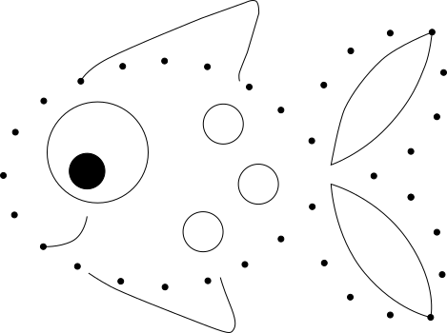
(453, 33)
(409, 34)
(172, 63)
(217, 69)
(367, 52)
(261, 90)
(339, 88)
(465, 75)
(128, 69)
(84, 84)
(294, 115)
(45, 105)
(458, 122)
(16, 138)
(326, 147)
(430, 158)
(3, 183)
(391, 184)
(327, 216)
(430, 206)
(14, 225)
(458, 243)
(44, 258)
(294, 250)
(256, 277)
(339, 275)
(462, 287)
(80, 279)
(126, 294)
(172, 300)
(217, 294)
(367, 311)
(409, 330)
(451, 332)

Slide 2
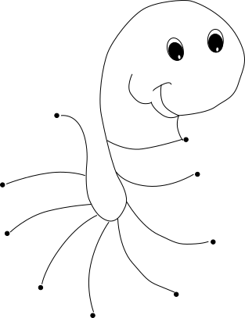
(72, 147)
(237, 178)
(251, 222)
(3, 236)
(272, 309)
(8, 298)
(224, 376)
(51, 368)
(118, 403)

